Slide 1
RUSTikales Rust for advanced coders

Slide 2
Plan for today

Slide 3
Plan for today
Introduction

Slide 4
Plan for today
Introduction
Recap on Rust Basics

Slide 5
Plan for today
Introduction
Recap on Rust Basics
General Info

Slide 6
Introduction
Welcome to this Rust course!

Slide 7
Introduction
Welcome to this Rust course!
Learning Rust is easy, Mastering it is hard

Slide 8
Introduction
Welcome to this Rust course!
Learning Rust is easy, Mastering it is hard
In this course, we will attempt to solve problems that arise from time to time

Slide 9
Introduction
Welcome to this Rust course!
Learning Rust is easy, Mastering it is hard
In this course, we will attempt to solve problems that arise from time to time
Lifetimes and Borrowing
Do lifetimes refer to memory locations? Do they refer to points in time?

Slide 10
Introduction
Welcome to this Rust course!
Learning Rust is easy, Mastering it is hard
In this course, we will attempt to solve problems that arise from time to time
Lifetimes and Borrowing
Do lifetimes refer to memory locations? Do they refer to points in time?
When is cloning really necessary?

Slide 11
Introduction
Welcome to this Rust course!
Learning Rust is easy, Mastering it is hard
In this course, we will attempt to solve problems that arise from time to time
Lifetimes and Borrowing
Do lifetimes refer to memory locations? Do they refer to points in time?
When is cloning really necessary?
How can we tell the compiler that our code would just work™️, if it wasn‘t for the Borrow Checker?

Slide 12
Introduction
Welcome to this Rust course!
Learning Rust is easy, Mastering it is hard
In this course, we will attempt to solve problems that arise from time to time
Lifetimes and Borrowing
Metaprogramming
Rust has a really strong macro system, allowing us to do all sorts of stuff

Slide 13
Introduction
Welcome to this Rust course!
Learning Rust is easy, Mastering it is hard
In this course, we will attempt to solve problems that arise from time to time
Lifetimes and Borrowing
Metaprogramming
Rust has a really strong macro system, allowing us to do all sorts of stuff
It‘s so powerful, it‘s turing-complete*

Slide 14
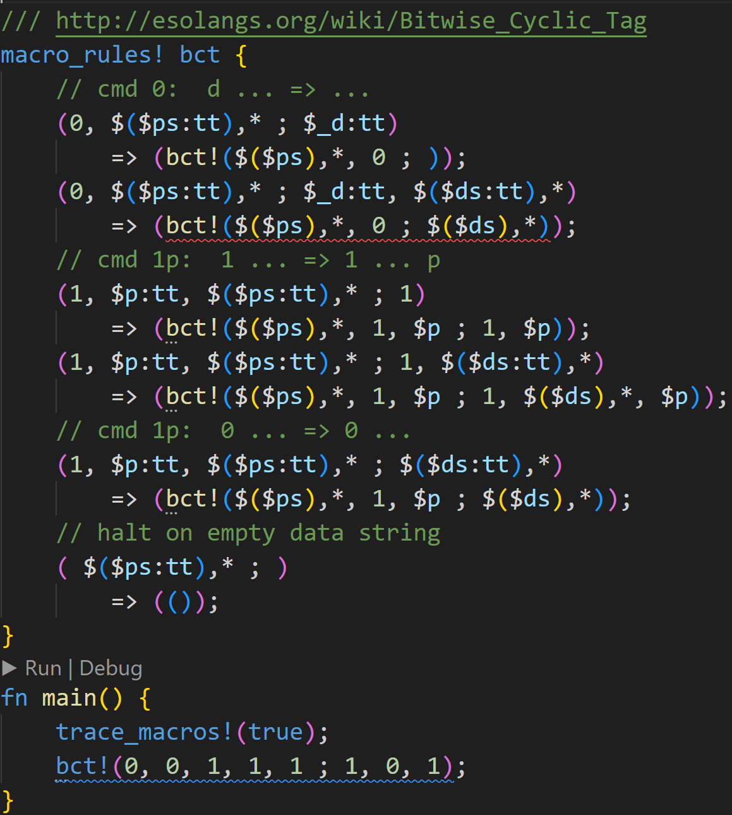
Source: https://mainisusuallyafunction.blogspot.com/2015/02/turing-tarpits-in-rusts-macro-system.html

Slide 15

Source: https://mainisusuallyafunction.blogspot.com/2015/02/turing-tarpits-in-rusts-macro-system.html
What

Slide 16
Source: https://mainisusuallyafunction.blogspot.com/2015/02/turing-tarpits-in-rusts-macro-system.html
Proof that macros are turing complete
Macros can emulate BCT
BCT can emulate Cyclic Tag Systems
CTS can emulate Tag Systems
Turing Machines can be transformed into a TS (Minsky, 1961)
Rust macros can emulate TM → Turing Complete
We could write a Rust compiler using Rust macros :^) (please don‘t)

Slide 17
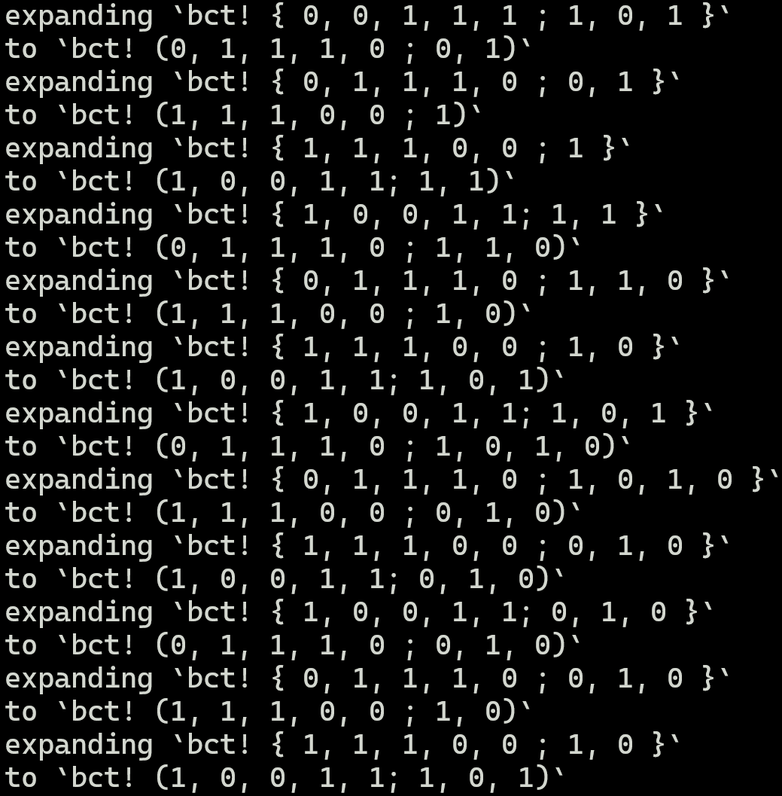
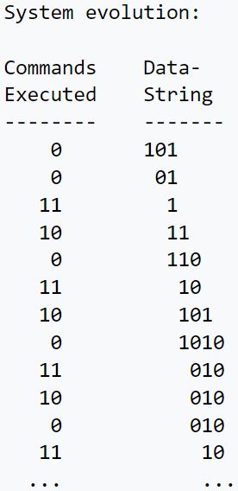

Source: https://mainisusuallyafunction.blogspot.com/2015/02/turing-tarpits-in-rusts-macro-system.html

Slide 18
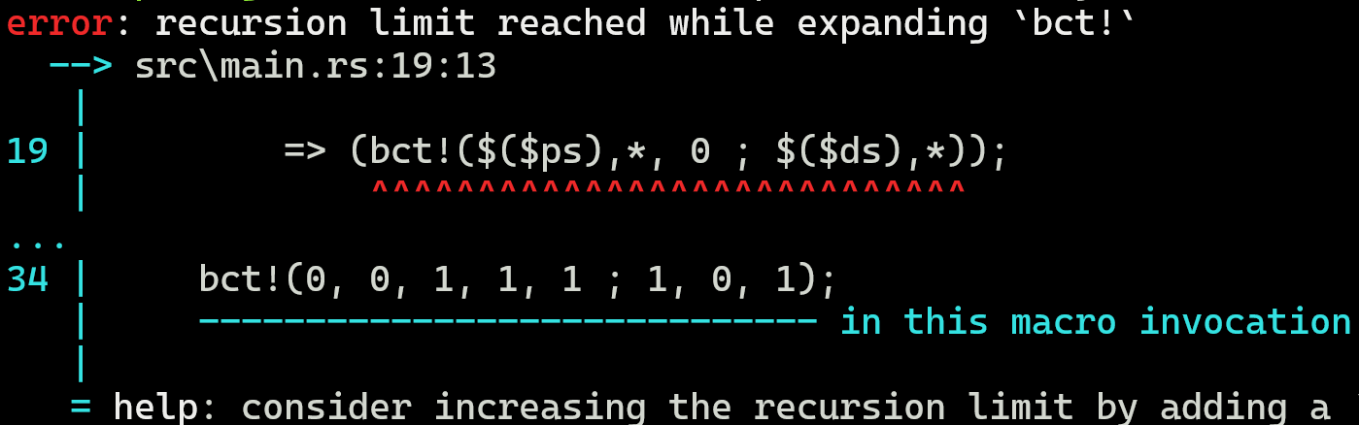
Source: https://mainisusuallyafunction.blogspot.com/2015/02/turing-tarpits-in-rusts-macro-system.html
Downside: The Rust compiler has a recursion limit on macros :^)

Slide 19
Introduction
Welcome to this Rust course!
Learning Rust is easy, Mastering it is hard
In this course, we will attempt to solve problems that arise from time to time
Lifetimes and Borrowing
Metaprogramming
Rust has a really strong macro system, allowing us to do all sorts of stuff
It‘s so powerful, it‘s turing-complete*
Allows us to work on Rust code itself as inputs and outputs
Code Generators

Slide 20
Introduction
Welcome to this Rust course!
Learning Rust is easy, Mastering it is hard
In this course, we will attempt to solve problems that arise from time to time
Lifetimes and Borrowing
Metaprogramming
Functional Programming
Rust idiomatic code does not like for

Slide 21
Introduction
Welcome to this Rust course!
Learning Rust is easy, Mastering it is hard
In this course, we will attempt to solve problems that arise from time to time
Lifetimes and Borrowing
Metaprogramming
Functional Programming
Rust idiomatic code does not like for
Instead, we have powerful Iterators which we can work with
filter()
map()

Slide 22
Introduction
Welcome to this Rust course!
Learning Rust is easy, Mastering it is hard
In this course, we will attempt to solve problems that arise from time to time
Lifetimes and Borrowing
Metaprogramming
Functional Programming
Rust idiomatic code does not like for
Instead, we have powerful Iterators which we can work with
Allows for lazy-evaluation and more optimizations

Slide 23
Introduction
Welcome to this Rust course!
Learning Rust is easy, Mastering it is hard
In this course, we will attempt to solve problems that arise from time to time
Lifetimes and Borrowing
Metaprogramming
Functional Programming
Multithreading
How can we create systems working on the same data, using multiple threads?
Example: You have a list of 1 billion elements, and want to concurrently work on them

Slide 24
Introduction
Welcome to this Rust course!
Learning Rust is easy, Mastering it is hard
In this course, we will attempt to solve problems that arise from time to time
Lifetimes and Borrowing
Metaprogramming
Functional Programming
Multithreading
How can we create systems working on the same data, using multiple threads?
How do we prevent race conditions and deadlocks without tanking performance?

Slide 25
Introduction
Welcome to this Rust course!
Learning Rust is easy, Mastering it is hard
In this course, we will attempt to solve problems that arise from time to time
Lifetimes and Borrowing
Metaprogramming
Functional Programming
Multithreading
Profiling
How can we find hotspots in our code?

Slide 26
Introduction
Welcome to this Rust course!
Learning Rust is easy, Mastering it is hard
In this course, we will attempt to solve problems that arise from time to time
Lifetimes and Borrowing
Metaprogramming
Functional Programming
Multithreading
Profiling
How can we find hotspots in our code?
How do we know if a certain implementation of a function is better?

Slide 27
Introduction
Welcome to this Rust course!
Learning Rust is easy, Mastering it is hard
In this course, we will attempt to solve problems that arise from time to time
Lifetimes and Borrowing
Metaprogramming
Functional Programming
Multithreading
Profiling
The focus will be more on the problems, and what you can do to solve them in Rust

Slide 28
Introduction
Welcome to this Rust course!
Learning Rust is easy, Mastering it is hard
In this course, we will attempt to solve problems that arise from time to time
Lifetimes and Borrowing
Metaprogramming
Functional Programming
Multithreading
Profiling
The focus will be more on the problems, and what you can do to solve them in Rust
There is no „single trick to beat them all“, everything has pros and cons
Technically, cloning also solves the Borrow Checker :^)

Slide 29
Introduction
Welcome to this Rust course!
Learning Rust is easy, Mastering it is hard
In this course, we will attempt to solve problems that arise from time to time
Lifetimes and Borrowing
Metaprogramming
Functional Programming
Multithreading
Profiling
The focus will be more on the problems, and what you can do to solve them in Rust
There is no „single trick to beat them all“, everything has pros and cons
By looking at the problems, you can extrapolate solutions to other programming languages
Rust has procedural macros to do X, can Python do something similar?
In Rust Y is recommended for multithreading, does C++ also support that?
Rust has Rc<T>, that‘s basically what Java does internally! → Now we can also optimize our Java code ☺

Slide 30
Introduction
Welcome to this Rust course!
Learning Rust is easy, Mastering it is hard
In this course, we will attempt to solve problems that arise from time to time
Lifetimes and Borrowing
Metaprogramming
Functional Programming
Multithreading
Profiling
The focus will be more on the problems, and what you can do to solve them in Rust
Each session will follow the same pattern

Slide 31
Introduction
Welcome to this Rust course!
Learning Rust is easy, Mastering it is hard
In this course, we will attempt to solve problems that arise from time to time
Lifetimes and Borrowing
Metaprogramming
Functional Programming
Multithreading
Profiling
The focus will be more on the problems, and what you can do to solve them in Rust
Each session will follow the same pattern
Try something that will not work (or at least takes a lot of effort) with what we know so far

Slide 32
Introduction
Welcome to this Rust course!
Learning Rust is easy, Mastering it is hard
In this course, we will attempt to solve problems that arise from time to time
Lifetimes and Borrowing
Metaprogramming
Functional Programming
Multithreading
Profiling
The focus will be more on the problems, and what you can do to solve them in Rust
Each session will follow the same pattern
Try something that will not work (or at least takes a lot of effort) with what we know so far
Introduce the problem, why does our initial attempt not work?

Slide 33
Introduction
Welcome to this Rust course!
Learning Rust is easy, Mastering it is hard
In this course, we will attempt to solve problems that arise from time to time
Lifetimes and Borrowing
Metaprogramming
Functional Programming
Multithreading
Profiling
The focus will be more on the problems, and what you can do to solve them in Rust
Each session will follow the same pattern
Try something that will not work (or at least takes a lot of effort) with what we know so far
Introduce the problem, why does our initial attempt not work?
What does Rust offer to solve the problem?

Slide 34
Recap of Rust Basics
Warning: I will now proceed to dump a semester worth of content into a single slide :^)

Slide 35
Recap of Rust Basics
Rust is a statically typed, compiled language

Slide 36
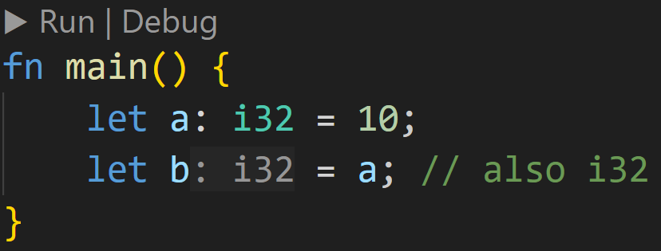
Recap of Rust Basics
Rust is a statically typed, compiled language
Every variable, every literal, everything has a type which can‘t be changed once determined
Type inference allows us to omit the type annotation

Slide 37
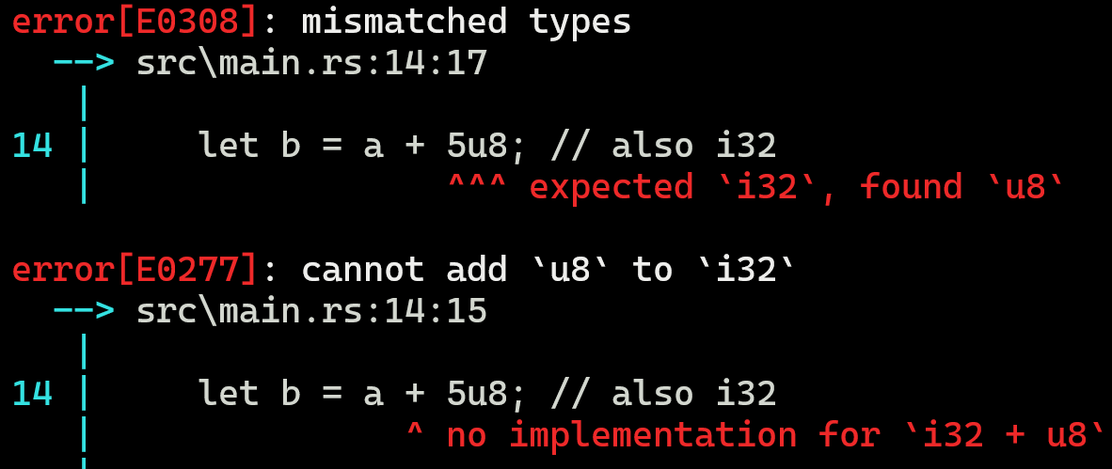
Recap of Rust Basics
Rust is a statically typed, compiled language
Every variable, every literal, everything has a type which can‘t be changed once determined
Static typechecker will catch errors at compile time

Slide 38
Recap of Rust Basics
Rust is a statically typed, compiled language
Every variable, every literal, everything has a type which can‘t be changed once determined
Static typechecker will catch errors at compile time
Compiled means machine code, which runs directly on your CPU → Faster than interpretation

Slide 39
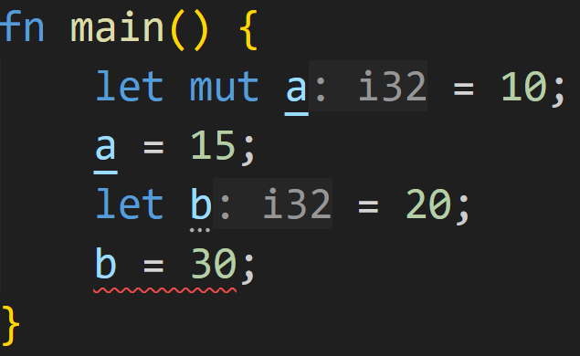
Recap of Rust Basics
Rust is a statically typed, compiled language
Rust allows us to specify the mutability of values

Slide 40
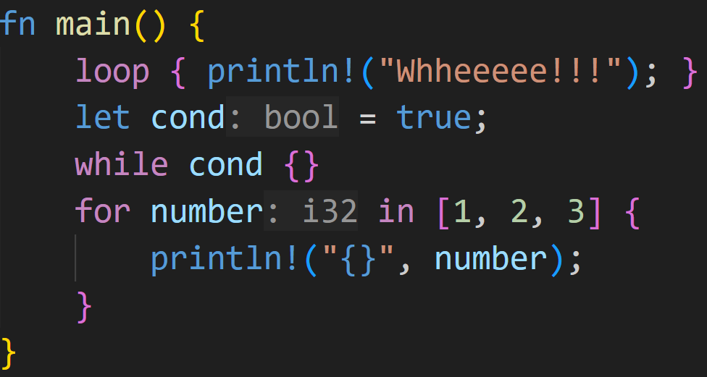
Recap of Rust Basics
Rust is a statically typed, compiled language
Rust allows us to specify the mutability of values
Rust has three types of loops

Slide 41
Recap of Rust Basics
Rust is a statically typed, compiled language
Rust allows us to specify the mutability of values
Rust has three types of loops
Ownership-Model
Every variable, every value, everything in Rust has exactly one owner
Values are dropped when the owner is dropped
Variables are dropped at the end of the scope they are defined in
Ownership-Conflicts are resolved by moving ownership, if the underlying value can‘t be copied

Slide 42
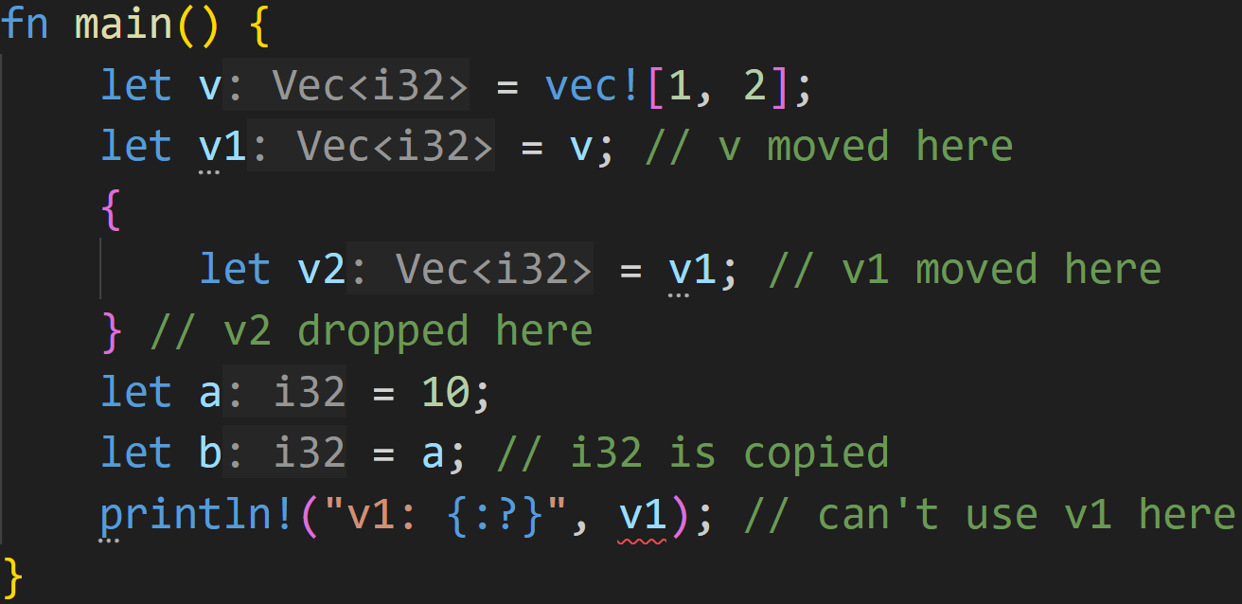
Recap of Rust Basics

Slide 43
Recap of Rust Basics
Rust is a statically typed, compiled language
Rust allows us to specify the mutability of values
Rust has three types of loops
Ownership-Model
Borrowing
Way of not moving or copying data when it‘s not needed
References
Can be mutable &mut or immutable &

Slide 44
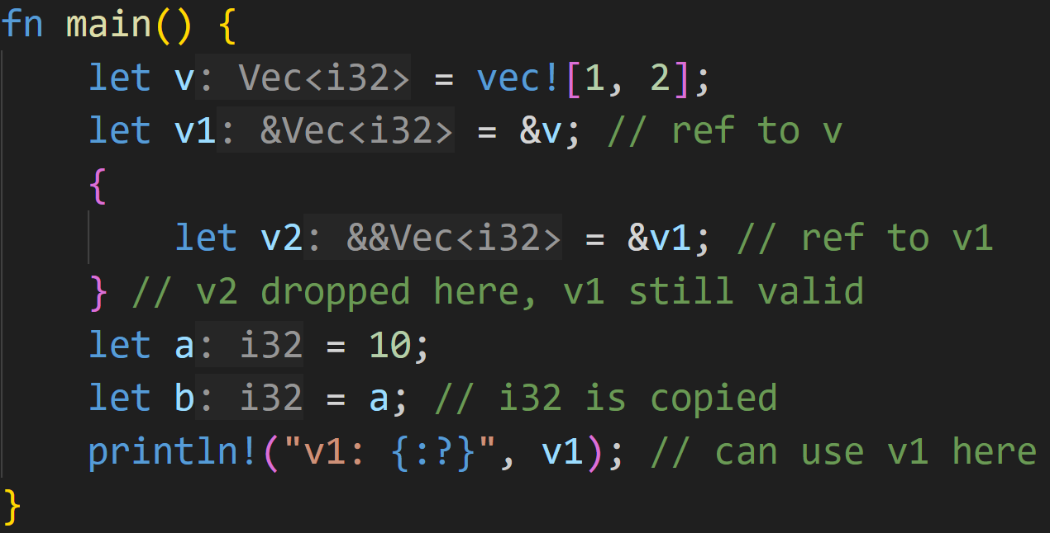
Recap of Rust Basics

Slide 45
Recap of Rust Basics
Rust is a statically typed, compiled language
Rust allows us to specify the mutability of values
Rust has three types of loops
Ownership-Model
Borrowing
Borrow-Checker
Mechanism to guarantee memory safety at compile time
0 mutable references to a value → infinite immutable references allowed
1 mutable reference to a value → zero immutable references allowed
more than 1 mutable reference to a value → illegal, compiler error
References must outlive original value → no dangling references
References only count when they are used → Lifetimes

Slide 46
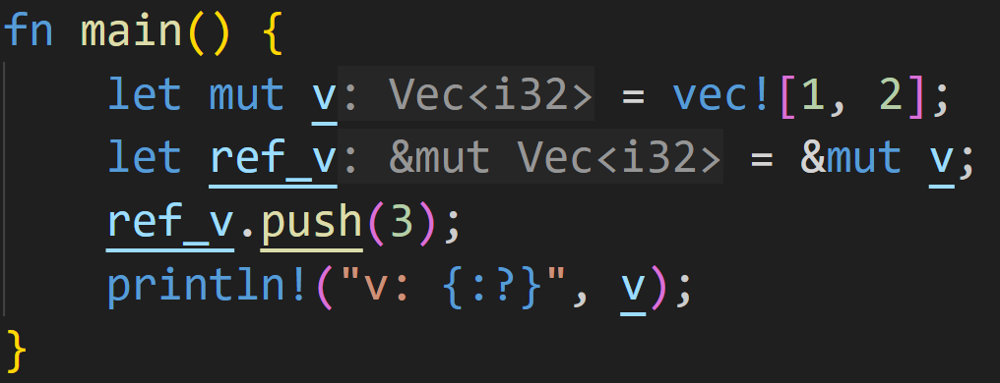
Recap of Rust Basics

Slide 47
Recap of Rust Basics
Lifetime* of original value

Slide 48
Recap of Rust Basics
Lifetime* of original value
Lifetime of mutable reference

Slide 49
Recap of Rust Basics
Lifetime* of original value
Lifetime of mutable reference
Reference does not outlive original, everything is okay

Slide 50
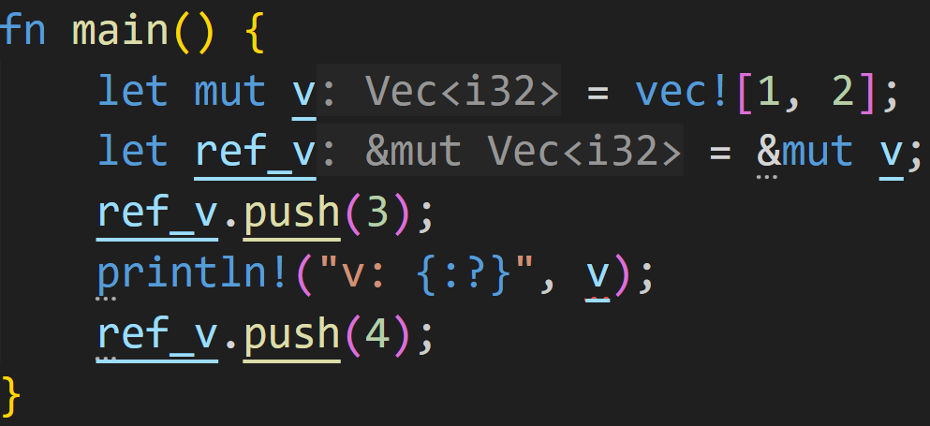
Recap of Rust Basics

Slide 51
Recap of Rust Basics
Lifetime* of original value

Slide 52
Recap of Rust Basics
Lifetime* of original value Lifetime of mutable reference

Slide 53
Recap of Rust Basics
Lifetime* of original value Lifetime of mutable reference
println creates an immutable reference

Slide 54
Recap of Rust Basics
Lifetime* of original value Lifetime of mutable reference
println creates an immutable reference
Mutable and Immutable overlap → Compilation error

Slide 55
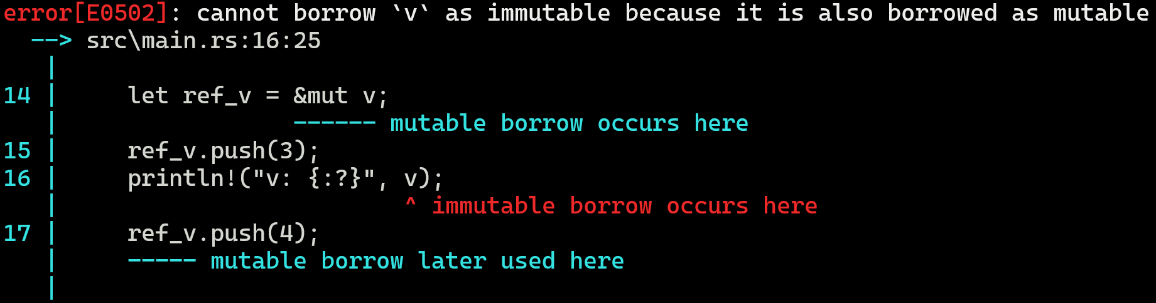
Recap of Rust Basics

Slide 56
Recap of Rust Basics
Rust is a statically typed, compiled language
Rust allows us to specify the mutability of values
Rust has three types of loops
Ownership-Model
Borrowing
Borrow-Checker
Functions fn
Take in parameters, and may return values
Overloading functions does not exist in Rust
No default arguments

Slide 57
Recap of Rust Basics
Rust is a statically typed, compiled language
Rust allows us to specify the mutability of values
Rust has three types of loops
Ownership-Model
Borrowing
Borrow-Checker
Functions fn
Structs struct
User-created data types
As such, can be used everywhere where types are required
Variable types
Function parameters
Struct fields
Made out of fields
Field names must be unique
Values of structs are called instances

Slide 58
Recap of Rust Basics
Rust is a statically typed, compiled language
Rust allows us to specify the mutability of values
Rust has three types of loops
Ownership-Model
Borrowing
Borrow-Checker
Functions fn
Structs struct
Associated functions impl
Associate a function with a given type
Used by calling <type_name>::<fn_name>()
Vec::new() is different from String::new(), which is also different from new()

Slide 59
Recap of Rust Basics
Rust is a statically typed, compiled language
Rust allows us to specify the mutability of values
Rust has three types of loops
Ownership-Model
Borrowing
Borrow-Checker
Functions fn
Structs struct
Associated functions impl
Methods
Associated functions where the first parameter is one of self, &self or &mut self
Can be called on instances of structs using <instance>.<method_name>()

Slide 60
Recap of Rust Basics
Rust is a statically typed, compiled language
Rust allows us to specify the mutability of values
Rust has three types of loops
Ownership-Model
Borrowing
Borrow-Checker
Functions fn
Structs struct
Associated functions impl
Methods
Traits trait
Traits are contracts
Implemented for a type by impl <trait_name> for <type_name> { <functions> }
Allow us to generalize our code
Instead of requiring a specific type, we can accept anything that implements a given trait

Slide 61
Recap of Rust Basics
Rust is a statically typed, compiled language
Rust allows us to specify the mutability of values
Rust has three types of loops
Ownership-Model
Borrowing
Borrow-Checker
Functions fn
Structs struct
Associated functions impl
Methods
Traits trait
Enums enum
Enum values are part of a finite set of Enum variants
Types of dog breeds is finite
Token types in a compiler is a finite, known set

Slide 62
Recap of Rust Basics
Rust is a statically typed, compiled language
Rust allows us to specify the mutability of values
Rust has three types of loops
Ownership-Model
Borrowing
Borrow-Checker
Functions fn
Structs struct
Associated functions impl
Methods
Traits trait
Enums enum
Pattern Matching match
match allows us to control the flow of the program → if-else on steroids
Allows us to access the data behind enum variants
Allows us to bind values to variables
Very powerful, almost everything in Rust uses it

Slide 63
Recap of Rust Basics
Rust is a statically typed, compiled language
Rust allows us to specify the mutability of values
Rust has three types of loops
Ownership-Model
Borrowing
Borrow-Checker
Functions fn
Structs struct
Associated functions impl
Methods
Traits trait
Enums enum
Pattern Matching match
Generics <T>
Allow us to generalize our code by writing data structures and functions that work with any type
Can be restricted using trait boundaries <T: Display + Debug>
Most famous: Option<T> and Result<T, E>

Slide 64
Recap of Rust Basics
Rust is a statically typed, compiled language
Rust allows us to specify the mutability of values
Rust has three types of loops
Ownership-Model
Borrowing
Borrow-Checker
Functions fn
Structs struct
Associated functions impl
Methods
Traits trait
Enums enum
Pattern Matching match
Generics <T>

Slide 65
General Info
Slides are available on the Github repository

Slide 66
General Info
Slides are available on the Github repository
I recommend cloning the repo, and doing regular pulls
Alternatively, Github also supports PDF rendering
Slides for the next session are always uploaded the weekend before

Slide 67
General Info
Slides are available on the Github repository
Every session will be split into three parts
Recap of last session
New topics
Exercises at the end

Slide 68
General Info
Slides are available on the Github repository
Every session will be split into three parts
Exercises and Code snippets in future slides will be colored coded
Green → 0/3 → We have covered the topic already, should be easy enough
Yellow → 1/3 → We have just covered the topic, may be hard
Red → 2/3 → Same as Yellow, but trickier
Purple → 3/3 → We have not covered the topic, but challenges are always fun

Slide 69
General Info
Slides are available on the Github repository
Every session will be split into three parts
Exercises and Code snippets in future slides will be colored coded
Participation and Feedback is very important
Basic program stands, but my goal is to teach you Rust the best I can
Don‘t understand something? Am I too fast? Did I make any mistake?
Just raise your hand, we can discuss a topic for a while! ☺
Slides are more of a guideline, technical conversations are always appreciated ☺

Slide 70
Next time
So, what are Lifetimes?
Slices

